Slide 1
Kaunas University of Applied Sciences (KUAS)
Practical and innovation-based higher education studies
TALENT ATTRACTION TO LITHUANIA
November 24, 2022

Slide 2
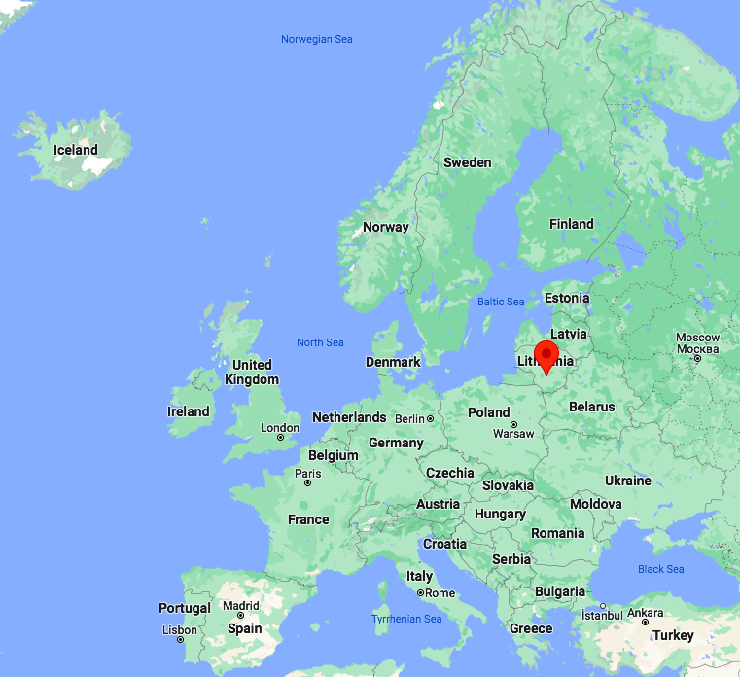
LOCATION

Slide 3
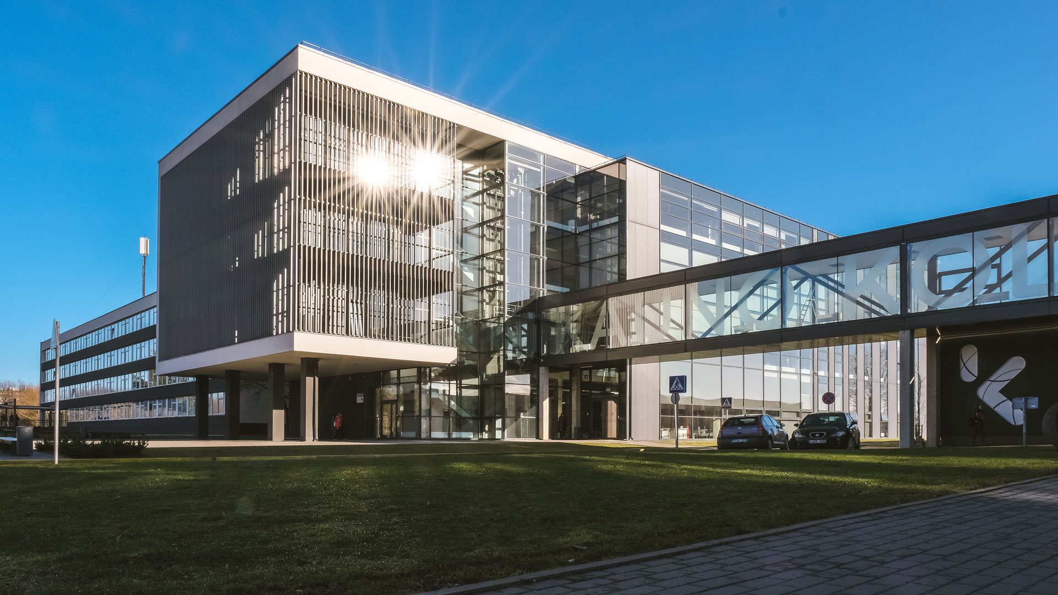
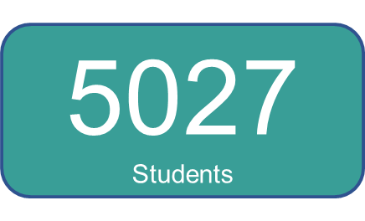
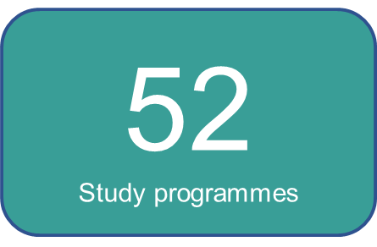
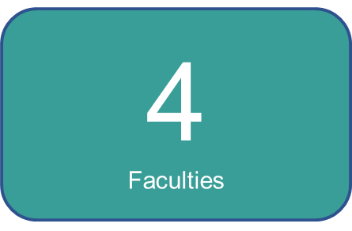
KUAS is one of the major state professional higher education institutions in Lithuania
KUAS meets the requirements of EU education policy
KUAS delivers practical and innovation-based higher education studies

Slide 4
KUAS Values
Openness
Professionalism
Respect
Responsibility
Sense of community
https://www.youtube.com/watch?v=pYAynaPHXww

Slide 5
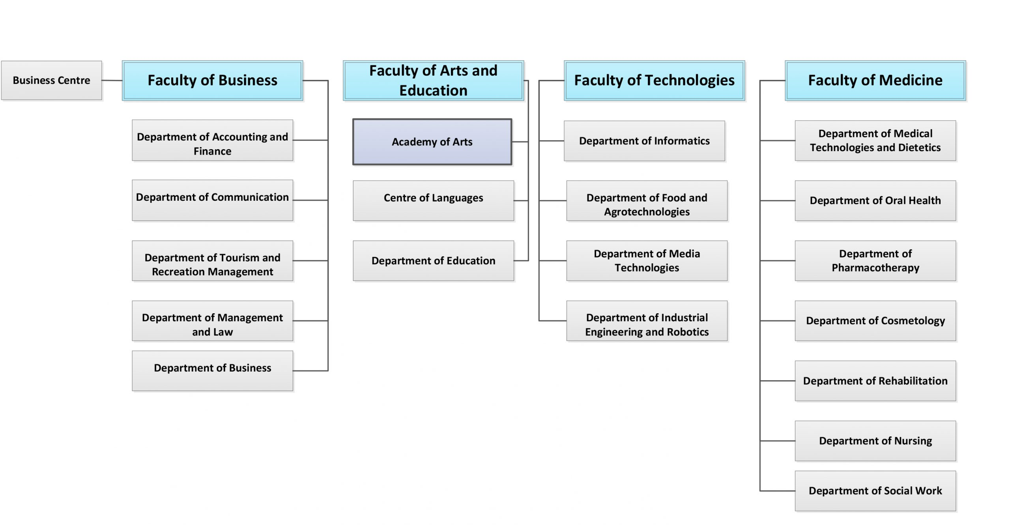

Slide 6
Faculty of Technologies
Computing (BA)
Cyber Systems and Security
Financial Technologies
Multimedia Technology
Software systems
Technological Sciences
Food Technology
Food Safety and Quality
Gastronomy and Catering
Graphic and Digital Media
Technologies for Creative Industry
Furniture Manufacturing Technologies
Engineering Sciences
Automation and Robotics
Geodesy
Industrial Design Engineering
Digital Electronics
Visual Communication Engineering
Agricultural Sciences
Agrobusiness Technologies

Slide 7
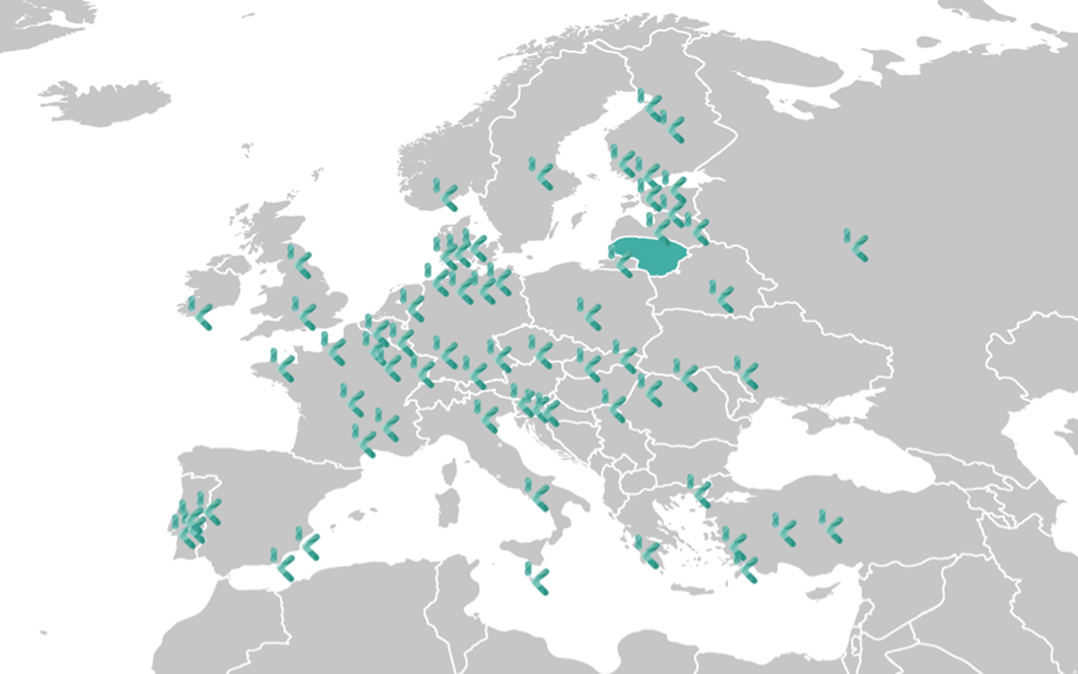
Strategical Priority No. 1 - Internationalisation
Objectives:
to conduct studies and other educational services relevant to the progress of the state and regional development;
to develop learner-centred studies and training services;
to develop the international openness of studies.
The University of North Carolina at Greensboro (USA), California State University - Chico (USA), etc.

Slide 8
Creating and developing cybersecurity educational content on social networks | Industrial systems and programming
5 ECTS | 3 ECTS
Field of education: Audio-visual Technology, Advertising Technology, Communication and Marketing. | Field of education: Electrical and electronic engineering
20.03.2022 – 07.04.2022 | Spring, 2022
Objectives: To create content that educates the user on how to behave safely on the Internet, to protect themselves from theft and scams. To analyse and organise information related to cyber security. To deepen the principles and development of communication. To create educational and preventive content for the general public, applying acquired knowledge of communication, cyber security, marketing, media technologies. | Objective: programme is to provide additional theoretical knowledge and practical skills related to the control processes of automation and robotics systems, the collection of relevant parameters systems and plant diagnostics.

Slide 9
Submission of a new BIP (2023)
Robotics for everyday life
3 ECTS
Field of education: Electrical and electronic engineering
Spring, 2023
The BIP programme is aimed at technical and engineering students who are looking for opportunities to use robots in different areas of our lives and to solve our everyday problems.

Slide 10
Collaboration with Business

Slide 11
Contact details:
Irma Spudyte, Vice Dean of the Faculty of Technologies, email: irma.spudyte@go.kauko.lt

